Slide 1
Stations of the crosss
By: Mikayla

Slide 2
Why do we have the stations of the cross?
The Stations of the Cross bring us closer to Jesus as we reflect on the great love He showed for us in His most powerful Passion!
We pray the Stations of the Cross (Aka: Way of the Cross) alone at anytime, but people most often pray them on Friday nights during Lent.
Tradition follows this loving tribute to the Lord back to the Blessed Mother’s following behind her son’s last steps, which also became known as the Via Dolorosa on His way to His Crucifixion at Calvary in Jerusalem.

Slide 3
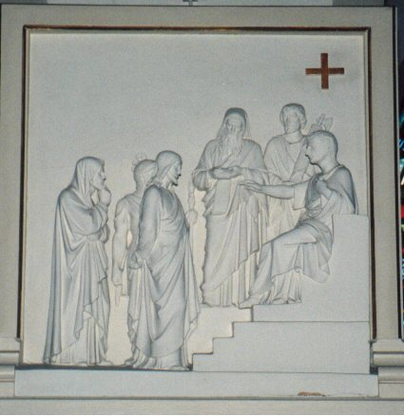
First Station Jesus is condemned to death
Matthew 27:15-26, Mark 16:6-15, Luke 23:17-25, John 18:33-40
Pilate found himself in confusion. He had to choose between what was faster and what was right, so he did what was faster and had Jesus crucified.

Slide 4
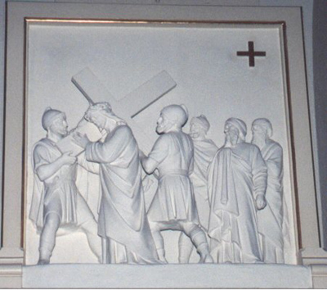
The Second Station: Jesus Carries His Cross.
Matthew 27:27-31, Mark 15:16-20, John 19:17
It was Roman practice to scourge, whip, and insult a prisoner, then make him carry the crossbeam of the cross to the site of the crucifixion. On the way, they made a public annocement of the prisoner and encouraged the crowds to insult him.

Slide 5
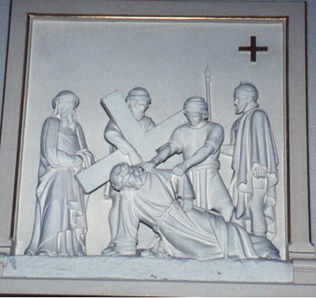
The Third Station: Jesus Falls the First Time.
Remembered in Christian memory
There is no scriptural reference that I can find that says directly that Jesus stumbled, but the fact that the soldiers had another man carry His cross for Him strongly implies it

Slide 6
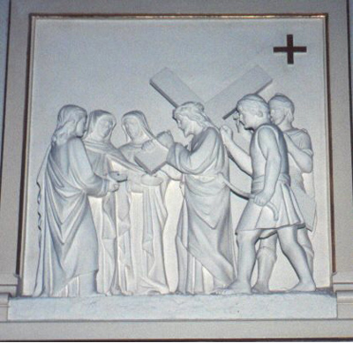
The Fourth Station: Jesus Meets His Mother
Remembered in Christian memory
There is no scriptural reference of Jesus meeting His mother along the way to the place of the crucifixion, but it is very likely that it happened. Mary was present at the crucifixion itself, so she was strongly motivated to make her way to Him while He was still carrying the cross.

Slide 7
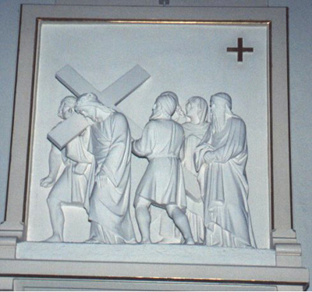
The Fifth Station: Simon Helps Jesus Carry His Cross
Matthew 27:32, Mark 15:21, Luke 23:26
Jesus had been up the whole night, first at a Passover Seder, then praying in the garden, then being arrested and convicted. He was tired even before He was scourged and whipped. The Romans wouldn’t want Him to die of exhaustion, because that would be merciful. They would only get someone else to carry the cross for Him if they had reason to believe that He might die too early and thus escape the torture of the cross.

Slide 8
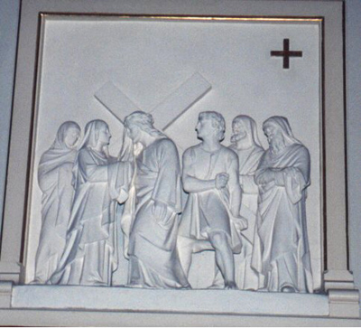
The Sixth Station: Veronica Wipes Jesus' Face.
Remembered in Christian memory
Jesus was bloody and sweaty from the problem according to Christian myth, a woman came forward and wiped His face with a cloth (traditionally called a napkin). When she took the cloth back, it had an image of Jesus’ face on it. If she just pressed the cloth to His face. The problem many people have with this story is that ‘Veronica’ was never used as a name before the story became widespread, and it is Greek for ‘true image.’ So many people think Veronica is a myth as well, but could be that this really did occur, that she had Veronica as a nickname, and that she proudly used it as her name.

Slide 9
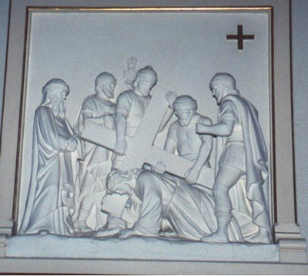
The Seventh Station: Jesus Falls the Second Time.
Remembered in Christian memory
There is no record in Scripture that I can find of Jesus stumbling again, but there is no reason to think that He didn’t.

Slide 10
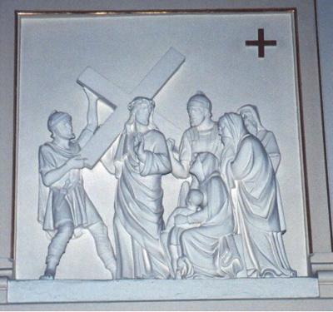
The Eighth Station: Jesus Meets the Women of Jerusalem
Luke 23:26-31
Jewish believe that a woman cannot be a witness in a trial. That protects women from violence by men who want to influence their trial before or punish them for it afterwards. This meant that the women had greater freedom of movement than the men, because they could not be required to give an account for what they saw and heard. That is why women figure prominently here and at the crucifixion.

Slide 11
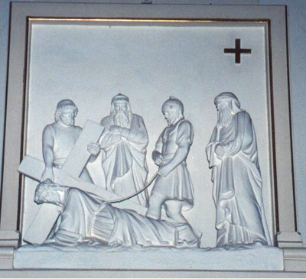
The Ninth Station: Jesus Falls the Third Time
Preserved in Christian memory
This last fall is devastating. Jesus can barely proceed to the end. Summoning all this remaining strength, supported by his inner trust in God, Jesus collapses under the weight of the cross. His executioners look at him as a broken man, pathetic yet paying a price he deserves. They help him up so he can make it up the hill of crucifixion

Slide 12
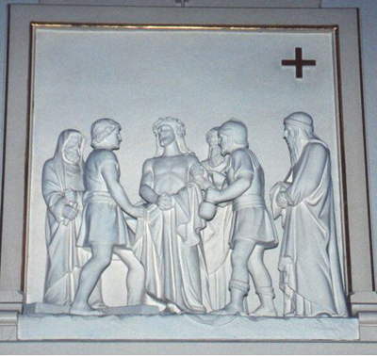
The Tenth Station: Jesus is Stripped.
Matthew 27:35, Mark 15:24b, Luke 23:34
The Romans not only tortured capital criminals, they also humiliated them publicly. For that reason, people were crucified in the nude. We learn here what Jesus had worn to the Last Supper: a himation, a sari-like garment, over a tunic. In other words, He was dressed in what we would call His Sunday best.

Slide 13
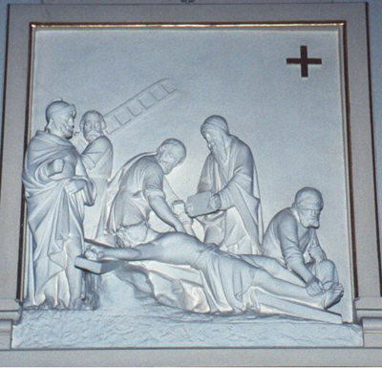
The Eleventh Station: Jesus is Nailed to the Cross
Matthew 27:35, Mark 15:24a, Luke 23:33, John 19:18
Huge nails are hammered through his hands and feet to fix him on the cross. He is bleeding much more seriously now. As the cross is lifted up, the weight of his life hangs on those nails. Every time he struggles to pull himself up to breathe, his ability to cling to life slips away

Slide 14
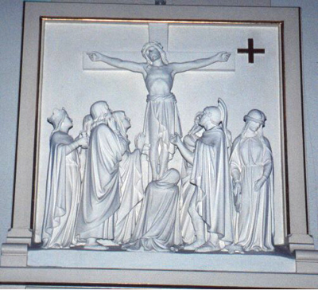
The Twelfth Station: Jesus Dies on the Cross.
Matthew 27:45-56, Mark 15:33-41, Luke 23:44-49, John 19:30-33
Between two criminals, a mocking title above his head, with only Mary and John and Mary Magdalene to support him, Jesus surrenders his last breath: "Into your hands I commend my spirit."

Slide 15
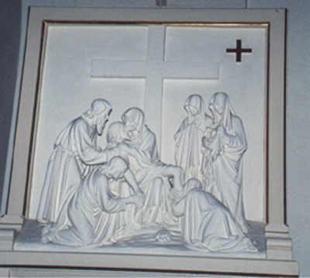
The Thirteenth Station: Jesus is Taken Down from the Cross
Matthew 27:57-61, Mark 15:42-47, Luke 23:50-56, John 19:38
The bodies had to be removed from the crosses before sundown to avoid profaning the Sabbath. The bodies were customarily thrown in a common grave for criminals, but Joseph stepped forward and asked for and received custody of Jesus’ body..

Slide 16
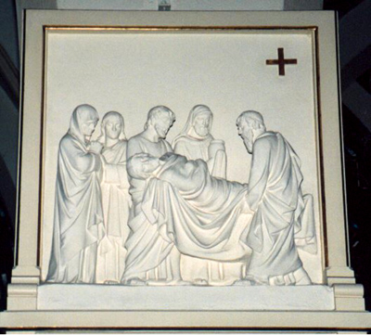
The Fourteenth Station: Jesus is Laid in the Tomb.
Matthew 27:57-58, John 19:39-42
Joseph and Nicodemus prepared Jesus for burial and put him in a tomb that Joseph had donated. Preparing bodies for burial was normally women’s work, so this is an act of devotion. The women witnessed this from afar. Because they stood at a distance and because it was near sundown, they could not see that Joseph and Nicodemus had prepared the body, but they did know where the tomb was.

Slide 17
Refrences
All references are found on:
http://onlineministries.creighton.edu/CollaborativeMinistry/stations.html
http://www.kencollins.com/instructions/how-15.htm

